Slide 1



CTH A Local Program Project
Robert St. – CTH X
Marinette Co./ WisDOT/ Contractor Business
Meeting
May 19, 2026
Notes:
Sarah to introduce project, meeting agenda and WisDOT team/

Slide 2
Meeting Agenda
Meeting Overview
  Introductions
  Prime Contractor and Subcontractors
  Proposed Work
  Project Schedule
  Traffic Impacts
  Q&A
Notes:
Sarah to introduce project, meeting agenda and WisDOT team/

Slide 3
Project Team
Project Construction Leader: Ed Hoefferle
Project Field Staff: Pam Kozloski and Matt Pietro
Project Manager: Sarah Ericson
Supervisor: Kristen Berg
Marinette County: Eric Burmeister
Notes:
Ed to introduce project, meeting agenda and WisDOT team/

Slide 4
Contractors
Prime Contractor: James Peterson Sons Inc.
Project Manager: Paul Church
Subcontractors:
  Bay Area Testing
  Northeast Asphalt
  Smith Restorations
  Hardrock Sawing
  WK Construction
  Sommers Construction
  Century Traffic
  Forward Traffic
  Wisconsin Land Surveying
Notes:
Paul to introduce the contractors

Slide 5
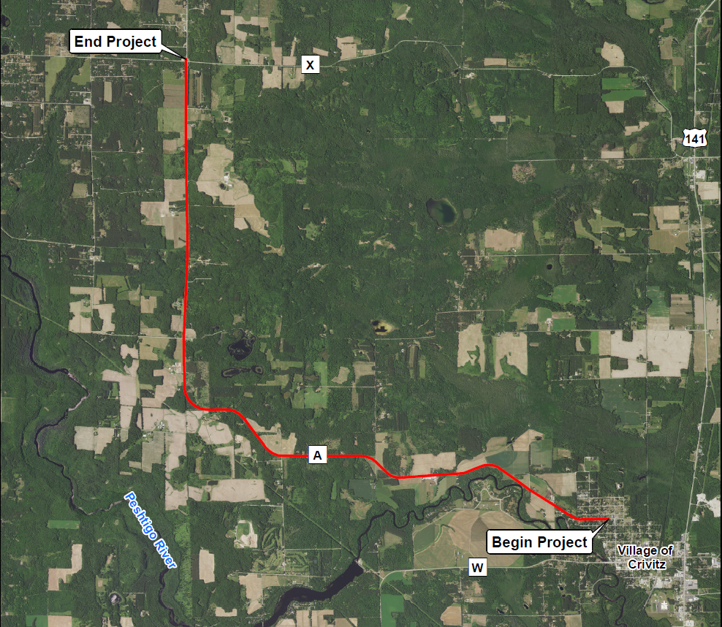
Project Location Map
Notes:
Ed To describe project location/limits

Slide 6
Proposed Work
Replace 8.6 miles of the existing pavement on County A.
Widen Shoulders from 3-ft to 6-ft from Rosa Ave. to Shaffer Rd. and from 3-ft to 4-ft from Schaffer Rd. to County X.
Correct roadway superelevations, complete tree clearing to improve sight distances, and add additional curve advisory signing.
Reconstruct 3 segments of County A between Newton Lake Rd. and Royal Ann Court to improve sight distance.
Guardrail or curb & gutter would be installed in select locations to limit impacts.
Additional work would include culvert replacements, pavement marking and permanent signing
Notes:
Ed To provide scope of work

Slide 7
Schedule
Project Award: March 25, 2026
Project Anticipated Start: Tuesday May 26, 2026
Contract Completion date: Friday October 30, 2026
Notes:
Paul will provide the schedule overview

Slide 8
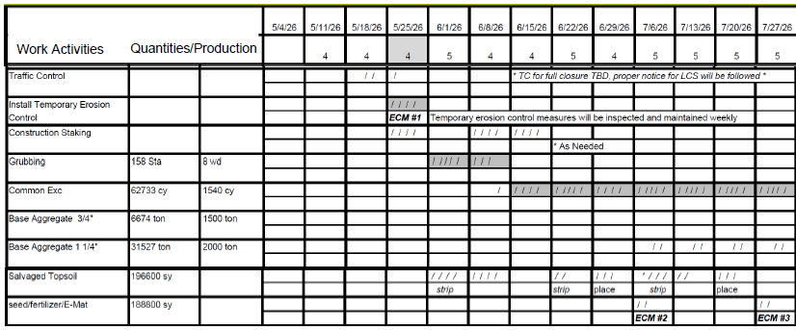
Schedule for June & July 2026
Notes:
Paul to run thru the stage work/schedule

Slide 9
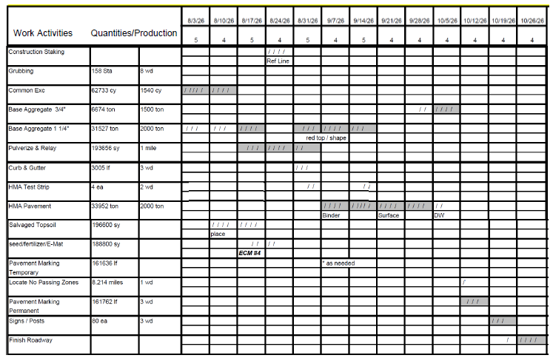
Schedule for August thru End of Project 2026
Notes:
Paul to run thru the stage work/schedule

Slide 10
Traffic Impacts
Traffic on CTH A (from Robert St. to Newton Lake Rd.) will include 2-way operations with single lane closures using flaggers.
Traffic on CTH A (from Newton Lake Rd. to CTH X) will be closed (local access only) for 50 Calendar days for grading work.
  The signed Alternate Route is USH 141 to CTH X to CTH A.
Access to driveways and side roads will be provided for the majority of construction. Short-term, temporary closures may occur during working hours.
  Contractor will contact affected properties.
Notes:
Ed to review these traffic impacts

Slide 11
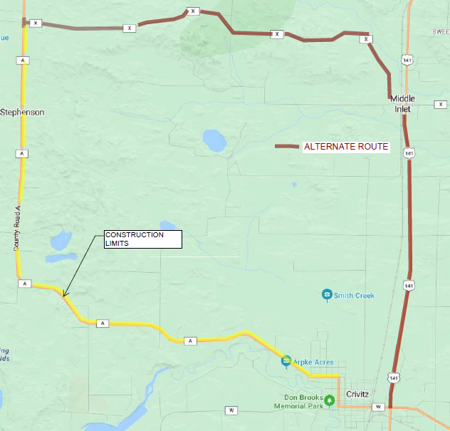
Traffic Impacts – CTH A: Alternate Route
US 141 to County X to County A
Notes:
Ed to explain the proposed signed detour for RR work (5 day closure)

Slide 12
Project Contacts
Ed Hoefferle Project Construction Leader WisDOT – Northeast Region 944 Vanderperren Way Green Bay, WI 54304-5344 Phone: (920) 366-0237 edward.hoefferle@dot.wi.gov | Sarah Ericson, P.E. Project Manager WisDOT – Northeast Region 944 Vanderperren Way Green Bay, WI 54304-5344 Phone:(920) 492-3511 sarah.ericson@dot.wi.gov
Notes:
Sarah to close out the meeting

Slide 13
Questions?
We would like to thank everyone for coming today. We thank you for your patience during the construction of this project and look forward to working with you.

